Slide 1
Regression
For classification, the output(s) is nominal
In regression, the output is continuous
  Function Approximation
Many models could be used – Simplest is linear regression
  Fit data with the best hyper-plane which "goes through" the points
y
dependent
variable
(output)
x – independent variable (input)

Slide 2
Simple Linear Regression
For now, assume just one (input) independent variable x, and one (output) dependent variable y
  Multiple linear regression assumes an input vector x
  Multivariate linear regression assumes an output vector y
We will "fit" the points with a line (i.e. hyper-plane)
Which line should we use?
  Choose an objective function
  For simple linear regression we choose sum squared error (SSE)
    Σ (predicted_{i} – actual_{i})² = Σ (residue_{i})²
  Thus, find the line which minimizes the sum of the squared residues (e.g. least squares)

Slide 3
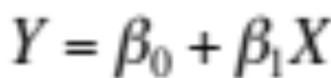
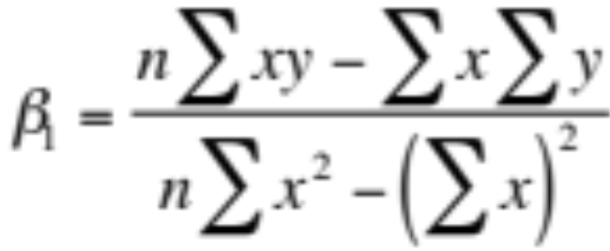
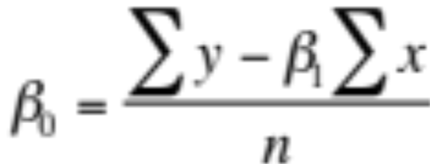
How do we "learn" parameters
For the 2-d problem (line) there are coefficients for the bias and the independent variable (y-intercept and slope)
To find the values for the coefficients which minimize the objective function we take the partial derivates of the objective function (SSE) with respect to the coefficients. Set these to 0, and solve.

Slide 4

Multiple Linear Regression
There is a closed form for finding multiple linear regression weights which requires matrix inversion, etc.
There are also iterative techniques to find weights
One is the delta rule. For regression we use an output node which is not thresholded (just does a linear sum) and iteratively apply the delta rule – thus the net is the output
Where c is the learning rate and x is input for that weight
Delta rule will update towards the objective of minimizing the SSE, thus solving multiple linear regression
There are many other regression approaches that give different results by trying to better handle outliers and other statistical anomalies

Slide 5
Intelligibility
One nice advantage of linear regression models (and linear classification) is the potential to look at the coefficients to give insight into which input variables are most important in predicting the output
The variables with the largest magnitude have the highest correlation with the output
  A large positive coefficient implies that the output will increase when this input is increased (positively correlated)
  A large negative coefficient implies that the output will decrease when this input is increased (negatively correlated)
  A small or 0 coefficient suggests that the input is uncorrelated with the output (at least at the 1st order)
Linear regression can be used to find best "indicators"
However, be careful not to confuse correlation with causality

Slide 6
SSE and Linear Regression Generalization
SSE chooses to square the difference of the predicted vs actual. Why square?
Don't want residues to cancel each other
Could use absolute or other distances to solve problem
  S |predicted_{i} – actual_{i}| : L1 vs L2
SSE leads to a parabolic error surface which is good for gradient descent
Which line would least squares choose?
  There is always one “best” fit
CS 478 - Regression

Slide 7
SSE and Linear Regression Generalization
SSE chooses to square the difference of the predicted vs actual. Why square?
Don't want residues to cancel each other
Could use absolute or other distances to solve problem
  S |predicted_{i} – actual_{i}| :
SSE leads to a parabolic error surface which is good for gradient descent
Which line would least squares choose?
  There is always one “best” fit
7
CS 478 - Regression

Slide 8
SSE and Linear Regression Generalization
SSE chooses to square the difference of the predicted vs actual. Why square?
Don't want residues to cancel each other
Could use absolute or other distances to solve problem
  S |predicted_{i} – actual_{i}| :
SSE leads to a parabolic error surface which is good for gradient descent
Which line would least squares choose?
  There is always one “best” fit
7
5
CS 478 - Regression

Slide 9
SSE and Linear Regression Generalization
SSE chooses to square the difference of the predicted vs actual. Why square?
Don't want residues to cancel each other
Could use absolute or other distances to solve problem
  S |predicted_{i} – actual_{i}| :
SSE leads to a parabolic error surface which is good for gradient descent
Which line would least squares choose?
  There is always one “best” fit
Note that the squared error causes the model to be more highly influenced by outliers
  Though best fit assuming Gaussian noise error from true surface
7
3
5
3
CS 478 - Regression

Slide 10
SSE and Linear Regression Generalization
In generalization all x values map to a y value on the chosen regression line
7
5
3
3
y – Input Value
1
0 1 2 3
x – Input Value
CS 478 - Regression

Slide 11
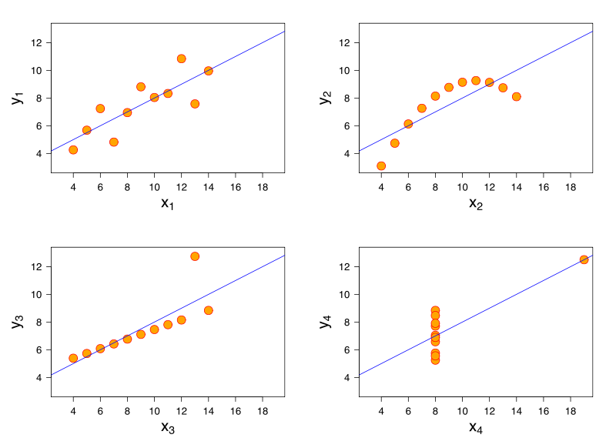
Anscombe's Quartet
What lines "really" best fit each case? – different approaches

Slide 12
Income | hrs/week |  | Income | hrs/week
8000 | 38 |  | 8000 | 35
6400 | 50 |  | 18000 | 37.5
2500 | 15 |  | 5400 | 37
3000 | 30 |  | 15000 | 35
6000 | 50 |  | 3500 | 30
5000 | 38 |  | 24000 | 45
8000 | 50 |  | 1000 | 4
4000 | 20 |  | 8000 | 37.5
11000 | 45 |  | 2100 | 25
25000 | 50 |  | 8000 | 46
4000 | 20 |  | 4000 | 30
8800 | 35 |  | 1000 | 200
5000 | 30 |  | 2000 | 200
7000 | 43 |  | 4800 | 30
Notes:
Discuss cleaning the data.
– 0 incomes out
– income and 0 hours out
– The 200 hours?

Slide 13
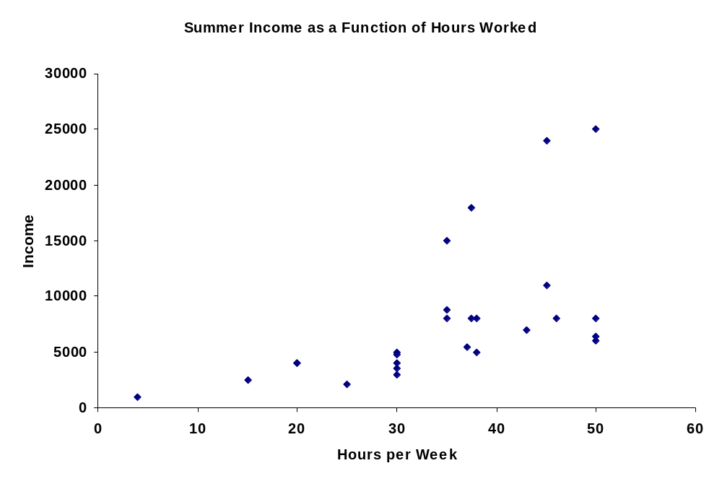

Slide 14
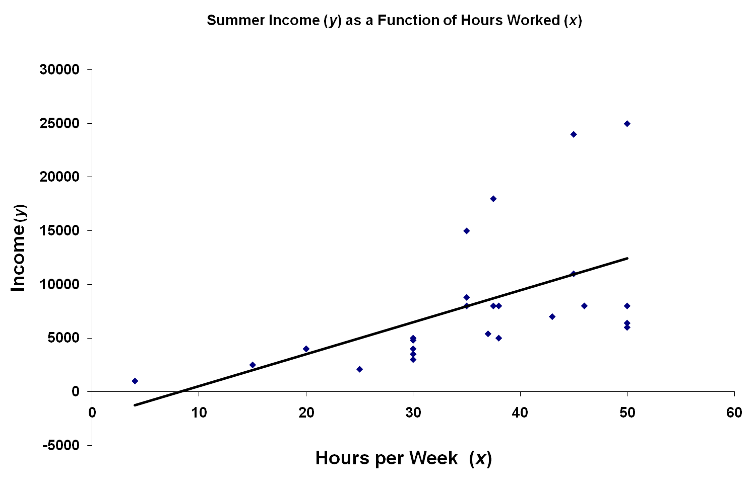
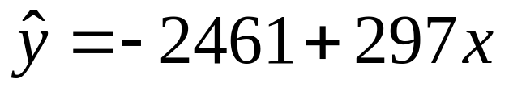
R² = 0.311
Significance = 0.0031
Notes:
Trendline shows the positive relationship.
Evidence of other variables?

Slide 15
Logistic Regression
One commonly used algorithm is Logistic Regression
Assumes that the dependent (output) variable is binary which is often the case in medical and other studies. (Does person have disease or not, survive or not, accepted or not, etc.)
Like Quadric, Logistic Regression does a particular non-linear transform on the data after which it just does linear regression on the transformed data
Logistic regression fits the data with a sigmoidal/logistic curve rather than a line and outputs an approximation of the probability of the output given the input

Slide 16
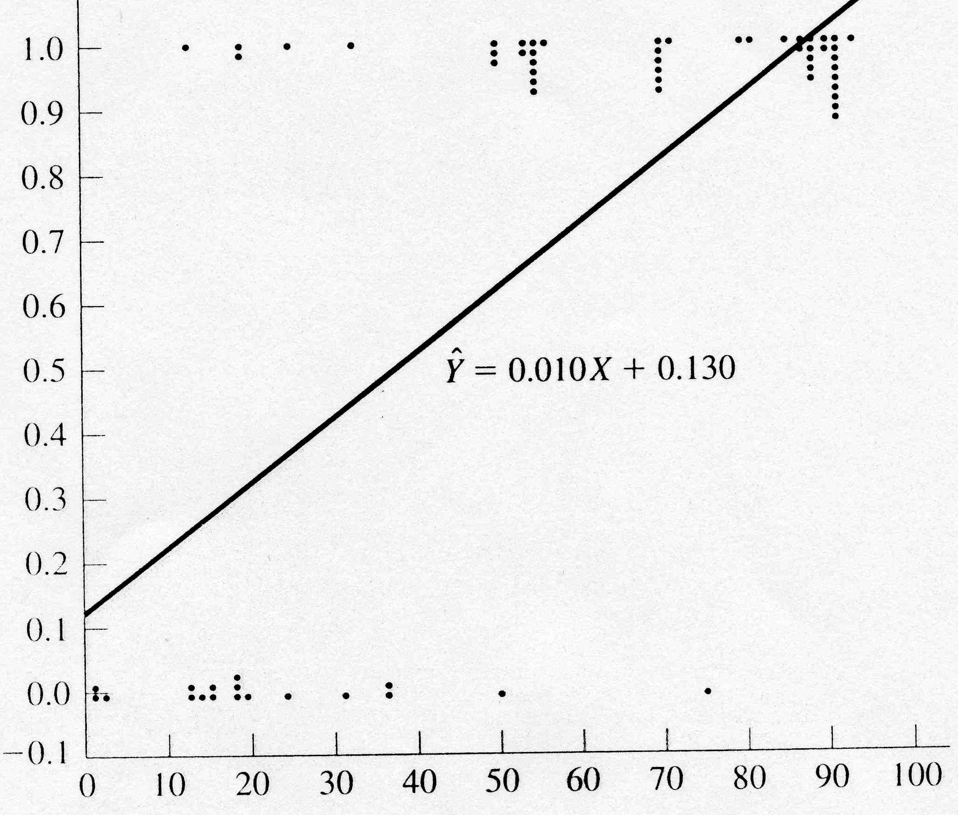
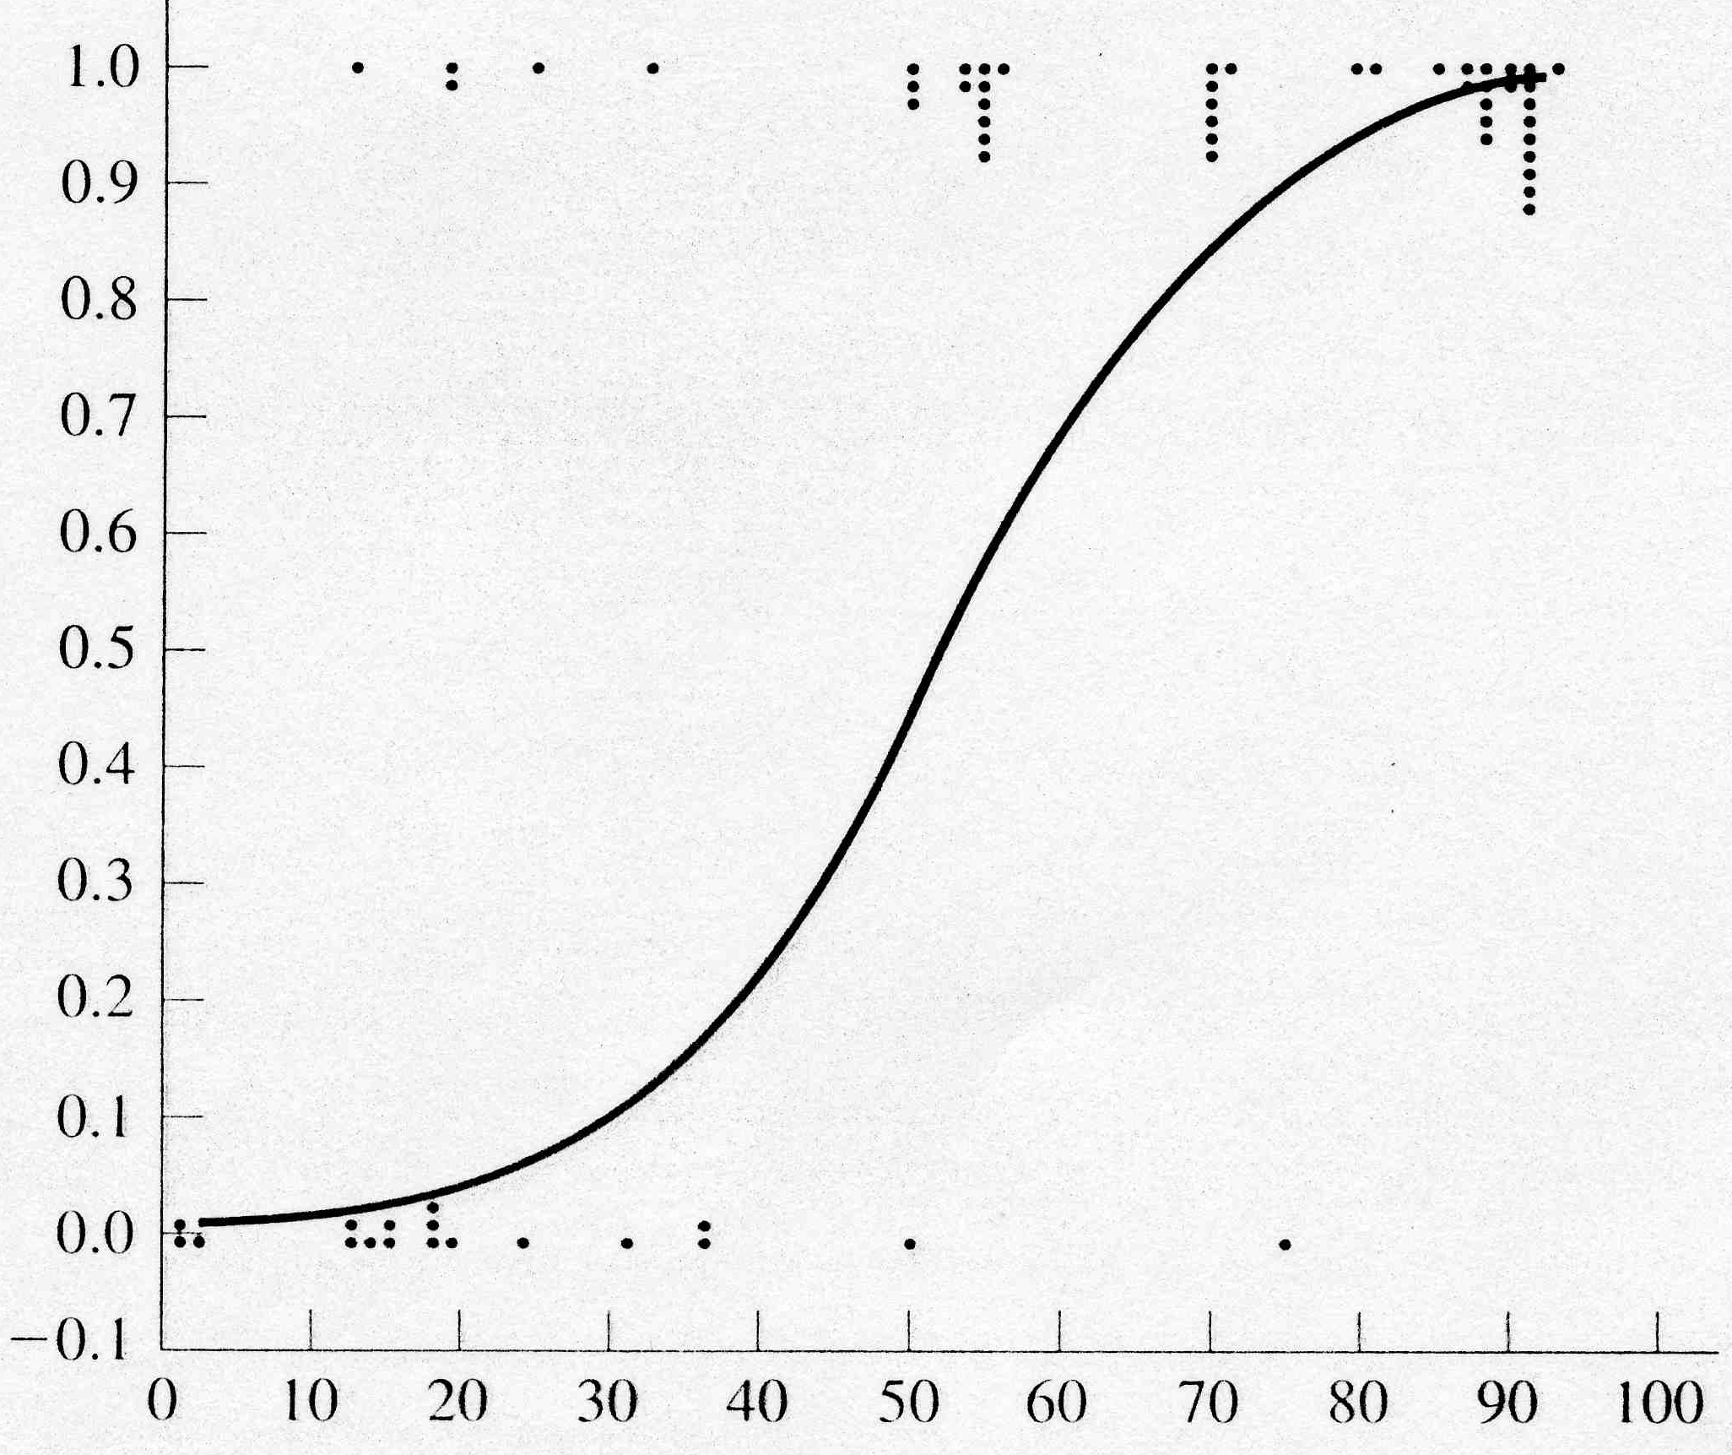
Logistic Regression Example
Age (X axis, input variable) – Data is fictional
Heart Failure (Y axis, 1 or 0, output variable)
Could use value of regression line as a probability approximation
  Extrapolates outside 0-1 and not as good empirically
Sigmoidal curve to the right gives empirically good probability approximation and is bounded between 0 and 1

Slide 17
Logistic Regression Approach
Learning
Transform initial input probabilities into log odds (logit)
Do a standard linear regression on the logit values
  This effectively fits a logistic curve to the data, while still just doing a linear regression with the transformed input (ala quadric machine, etc.)
Generalization
Find the value for the new input on the logit line
Transform that logit value back into a probability

Slide 18
Maximum Likelihood Estimation (MLE)
MLE is a statistical method for estimating the coefficients of a model.
The likelihood function (L) measures the probability of observing the particular set of dependent variable values (p₁, p₂, ..., p_{n}) that occur in the sample:
L = Prob (p₁* p₂* * * p_{n})
The higher the L, the higher the probability of observing the ps in the sample.

Slide 19
Maximum Likelihood Estimation (MLE)
MLE involves finding the coefficients (α, β) that makes the log of the likelihood function (LL < 0) as large as possible
Or, finds the coefficients that make -2 times the log of the likelihood function (-2LL) as small as possible
The maximum likelihood estimates solve the following condition:
{Y - p(Y=1)}X_{i} = 0
summed over all observations, i = 1,…,n

Slide 20
Non-Linear Pre-Process to Logit (Log Odds)
Medication Dosage | # Cured | Total Patients | Probability: # Cured/Total Patients
20 | 1 | 5 | .20
30 | 2 | 6 | .33
40 | 4 | 6 | .67
50 | 6 | 7 | .86
Cured
1
prob.
Cured
Not Cured
0
0 10 20 30 40 50 60
0 10 20 30 40 50 60

Slide 21
Regression of Log Odds
Medication Dosage | # Cured | Total Patients | Probability: # Cured/Total Patients | Odds: p/(1-p) = # cured/ # not cured | Log Odds: ln(Odds)
20 | 1 | 5 | .20 | .25 | -1.39
30 | 2 | 6 | .33 | .50 | -0.69
40 | 4 | 6 | .67 | 2.0 | 0.69
50 | 6 | 7 | .86 | 6.0 | 1.79
+2
0
-2
0 10 20 30 40 50 60
1
prob.
Cured
0
y = .11x – 3.8 - Logit regression equation
Now we have a regression line for log odds (logit)
To generalize, we interpolate the log odds value for the new data point
Then we transform that log odds point to a probability: p = e^{logit(x)}/(1+e^{logit(x)})
For example assume we want p for dosage = 10
Logit(10) = .11(10) – 3.8 = -2.7
p(10) = e^{-2.7}/(1+e^{-2.7}) = .06 [note that we just work backwards from logit to p]
These p values make up the sigmoidal regression curve (which we never have to actually plot)

Slide 22
Summary
Linear Regression and Logistic Regression are nice tools for many simple situations
  But both force us to fit the data with one shape (line or sigmoid) which will often underfit
Intelligible results
When problem includes more arbitrary non-linearity then we need more powerful models which we will introduce
  Though non-linear data transformation can help in these cases while still using a linear model for learning
These models are commonly used in data mining applications and also as a "first attempt" at understanding data trends, indicators, etc.

